Slide 1
Poster Initiation
Insights, Expectations, and Initiation
Spring 2026

Slide 2
Agenda
Symposium & Poster Purpose
Poster Critique Insights
Poster Section Expectations
Poster Initiation
1
2
3
4

Slide 3
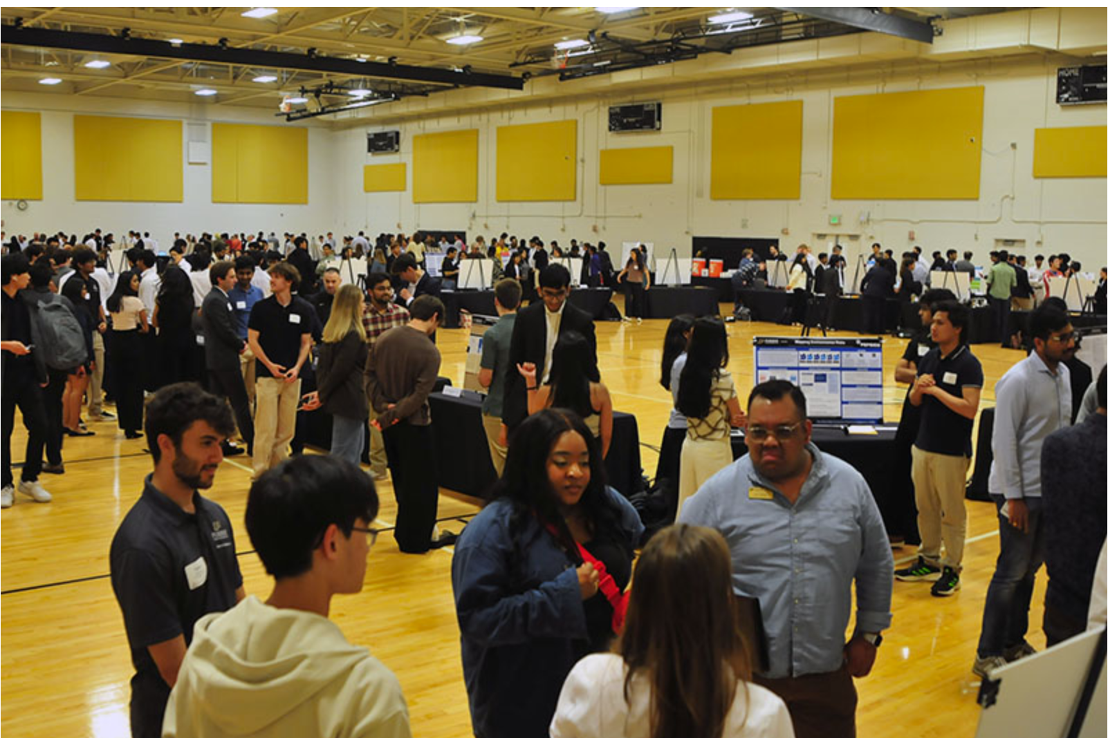
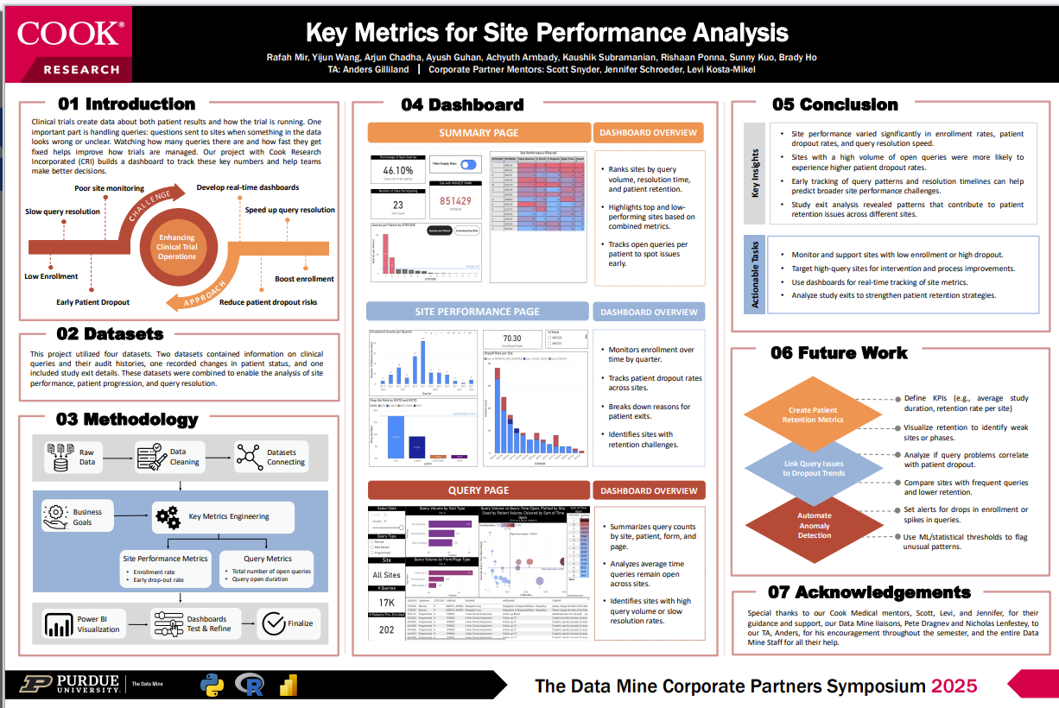
Symposium & Poster Purpose
What is the symposium for?
Why do we create a poster?

Slide 4
Poster Critique Insights
Categories | What to replicate | What to avoid
1. Introduction / Motivation
2. Methods
3. Conclusions
4. Future Goals
5. References & Acknowledgements
6. Figures
7. Layout & Design
Pair Discussion based on PD 9
Team 1
Step 1: Individual recall
Recall/check the feedback you wrote in PD 9 for both posters
Step 2: Pair discussion
Which parts of the posters were clear and effective, that should be replicated?
Which parts were confusing, weak, or distracting that should be avoided?
Step 3: Share insights specific to categories
2 notes what to replicate
2 notes what to avoid
Team 2
Team 1
Team 1
Team 2
Team 2
Team 1
Team 2

Slide 5
Poster Section Expectations
Categories | Poster Expectation
1. Introduction / Motivation
2. Methods
3. Conclusions
4. Future Goals
5. References & Acknowledgements
6. Figures
7. Layout & Design
Team Discussion (by category)
Team 1
Team 2
Team 4
Team 3
Review notes within each category
If notes conflict, agree on the approach you will take as a team
If a category has no notes, agree on expectations for this section of your poster (replicate/avoid)
Convert Poster Section Expectations board into a file and save it in your MS Teams Channel
Team 3
Team 1
Team 4
Entire Team
Team 1
Team 2
Team 3
Team 2
Team 3
Team 4
Team 4
Team 1
Team 2
Entire Team
5

Slide 6
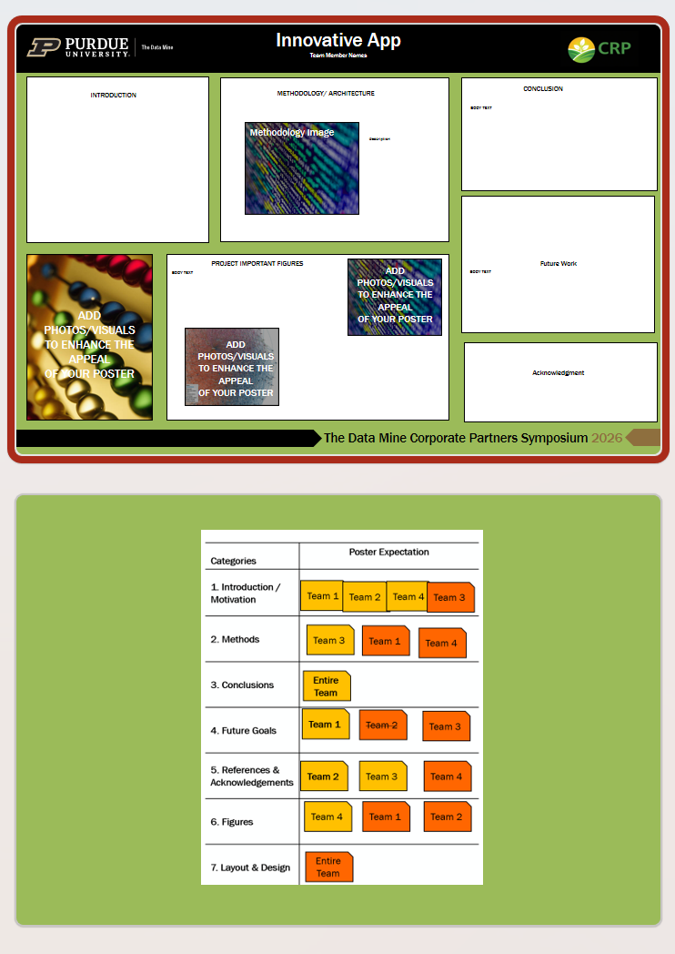
Our Poster Initiation
24x36 in size!
Deliverables - TA submits on your behalf by 2/25/2026
Poster initiation
24x36 PPT (print size)
CRP Branding Colors
Poster title and logos
Rough section layout (editable)
Save Poster PPT in your MS Teams Channel
6

Slide 7
Thank You

